Slide 1

AI BASED NOISE- CANCELLATION USING DCU-NET ARCHITECTURE
EC-392 B.Tech Project
Semester-VI 2023-24
Group members:
Avnesh Kumar (21095029)
Soojal Singh (21095115)
Ravi Kumar Meena(21095093)
Under the guidance of
Dr. Kishor P. Sarawadekar
Associate Professor
Department of Electronics Engineering
Indian Institute Of Technology (BHU) Varanasi

Slide 2
Introduction
Speech enhancement is one of the most important and challenging tasks in speech applications where the goal is to separate clean speech from noise when noisy speech is given as an input.
Right now, most of the devices use ANC(Active Noise Cancellation) for achieving speech enhancement. In this technique, an anti-noise with the same amplitude and opposite phase is generated and combined with an unwanted noise, thus resulting in the cancellation of both noises. But it requires hardware devices and physical mechanisms thus making it unadaptable.
Thus, we have utilized a neural networks-based approach for the same in our project.
We have used the Noise-to-Noise approach for training our DCU-Net(Deep-Complex U-Net) model trained over a large dataset containing noisy files. Noise-to-Noise means the input noisy file is trained against another noisy file as the target. DCU-Net model contains encoder part that extracts features from image by down-sampling it and then a decoder structure that takes extracted features, upscales them and reconstructs a segmentation mask. The mask is an anti-noise mask which when multiplied with the input noisy spectrogram cancels out the noise part of the file.

Slide 3
Motivation - Our Approach for AI Based Model
This project tackles the problem of the heavy dependence of clean speech data required by deep learning based audio denoising methods by showing that it is possible to train deep speech denoising networks using only noisy speech samples.
Furthermore it is revealed that such training regimes achieve superior denoising performance over conventional training regimes utilizing clean training audio targets, in cases involving complex noise distributions and low Signal-to-Noise ratios (high noise environments).
We demonstrate the effectiveness of this Noise2Noise approach using the 20 layered Deep Complex U-Net (DCUnet20) architecture. This complex-valued masking framework is an extension upon the popular U-Net architecture . It is able to more precisely understand and recreate both phase and magnitude information from spectrograms.

Slide 4
The approach is to use an end-to-end model which takes noisy audio as raw waveform inputs. First, the time domain waveform is converted into the time-frequency domain using the Short Time Fourier Transform (STFT). The output is a complex matrix spectrogram which contains real valued magnitude component and a complex valued phase component.
This spectrogram is fed to our DCU-NET 20 model(here 20 signifies the model length) which generates an anti-noise spectrogram containing both the real valued magnitude and complex valued phase of the noise in the input signal. When this mask is multiplied with the input noisy signal spectrogram , the noise portion get cancelled out and we get the predicted clean speech spectrogram. Then the ISTFT of the obtained spectrogram is perform which gives our predicted speech enhanced output signal.

Slide 5
Project Overview
Implemented Noise-to-Noise approach rather than Noise-to-Clean providing better performance.
Datasets used :-
1.“UrbanSound8k” – Contains sample files for 10 different noise types.
2“Voice Bank + Demand” – Contains clean speech samples
Overlayed noise signal repetitively on clean speech to generate noise input files for further process using PyDub.

Slide 6
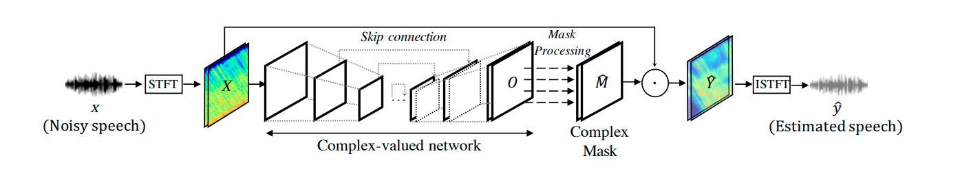
Illustration of Speech Enhancement framework with DCU-Net
Noisy waveform converted from time-domain to time-frequency domain(using STFT).
The model is passed the obtained STFT. The model outputs an estimated mask.
Multiplying the estimated mask with input STFT mask gives the estimated speech STFT.
Taking the ISTFT gives the required predicted clean speech.

Slide 7
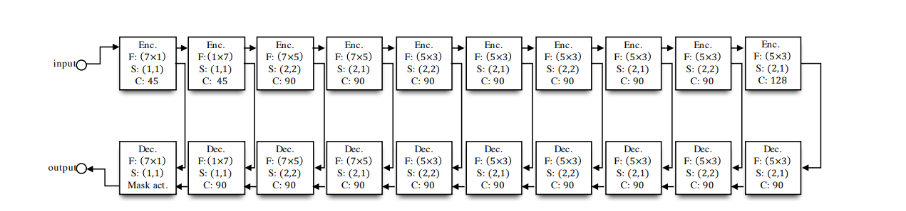
DCU-Net model architecture
10 layered DCU-Net(10 encoders and 10 decoders) with their respective parameters including filter size, stride, number of channels and corresponding skip connections.

Slide 8
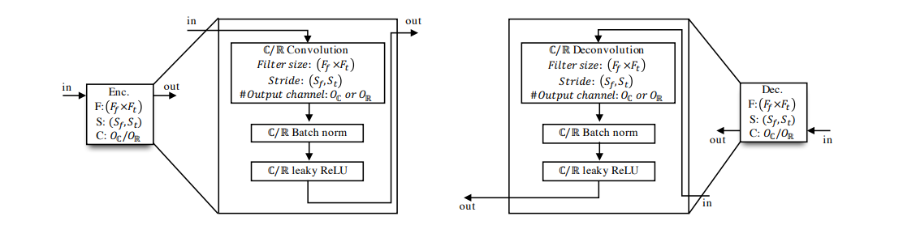
Description of Encoder and Decoder Block
Convolution operation is performed in encoder part to extract the features and in decoder
to reconstruct a segmentation mask.

Slide 9
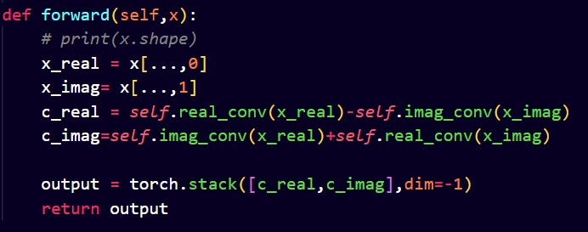
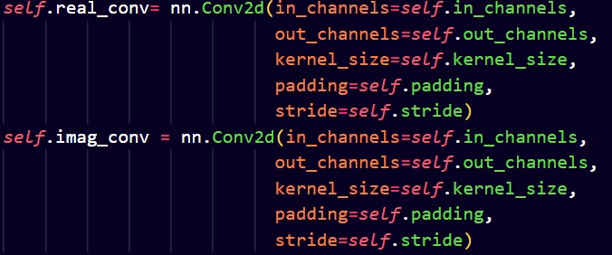
Convolution operation in Encoder
Given a complex-valued convolution filter, W = A + iB with real-valued matrices A and B,
the complex convolution operation of complex vector H = X + iY with W is given by,
W*H = (A*X – B*Y) + i(B*X + A*Y)

Slide 10
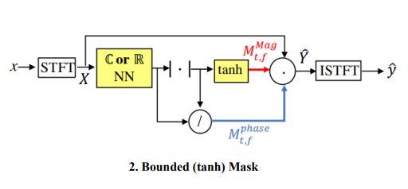
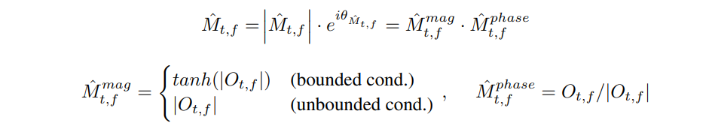
Convolution operation in Decoder
To bound the magnitude of the mask and
Optimize the overall performance of the
Model, tanh function is used.

Slide 11
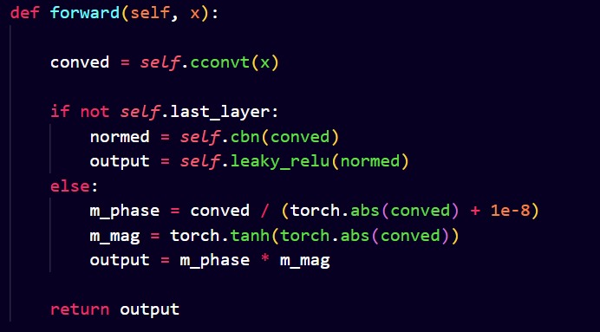
Implementation of above stated magnitude optimization

Slide 12

Loss Function
The following loss function is utilized for optimizing the weights. The weights are initialized through Xavier function(Xavier uniform distribution).
Where,
α = ||y||²/ (||y||² + ||z||²)
And,
zˆ = x−yˆ
α is the energy ratio between clean speech y and noise z.

Slide 13
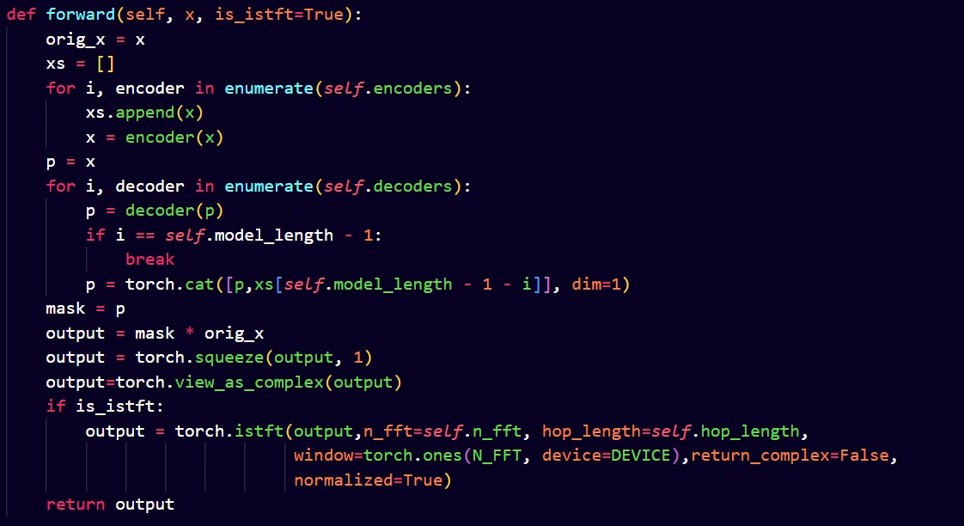
Code for the DCU-Net20 Model

Slide 14
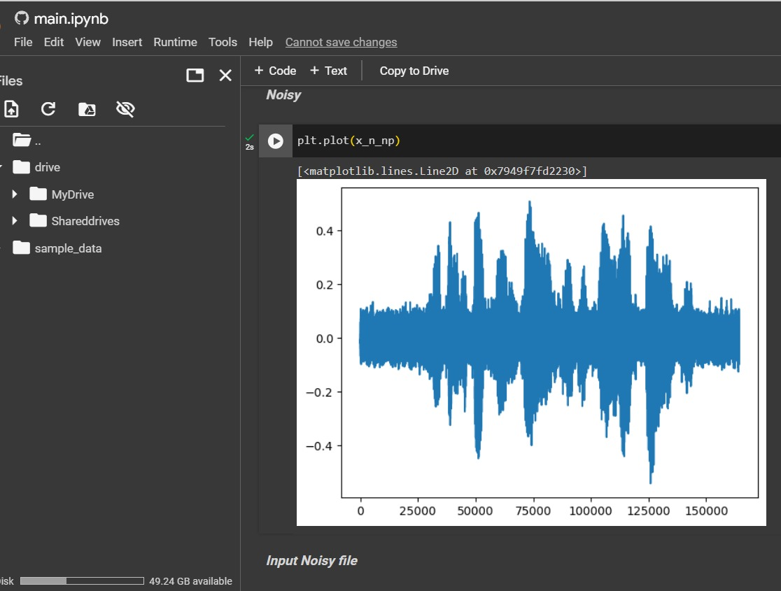
Results and Inferences
Input Noisy Signal

Slide 15
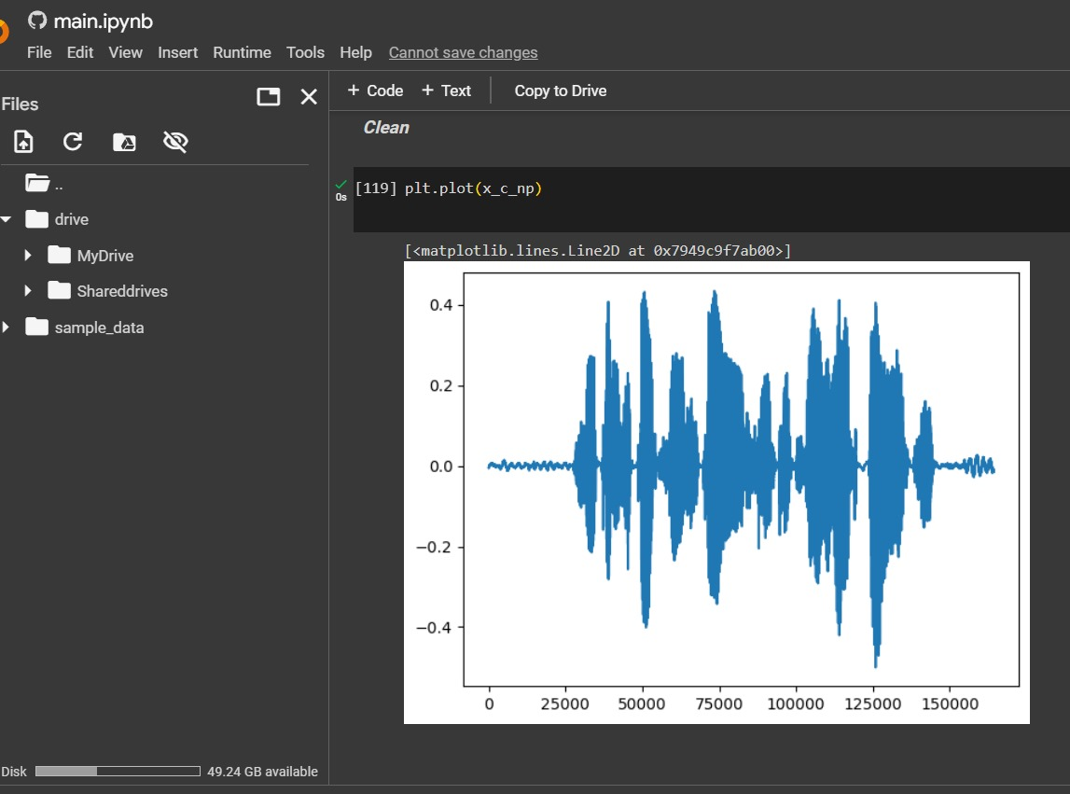
Clean Speech signal

Slide 16
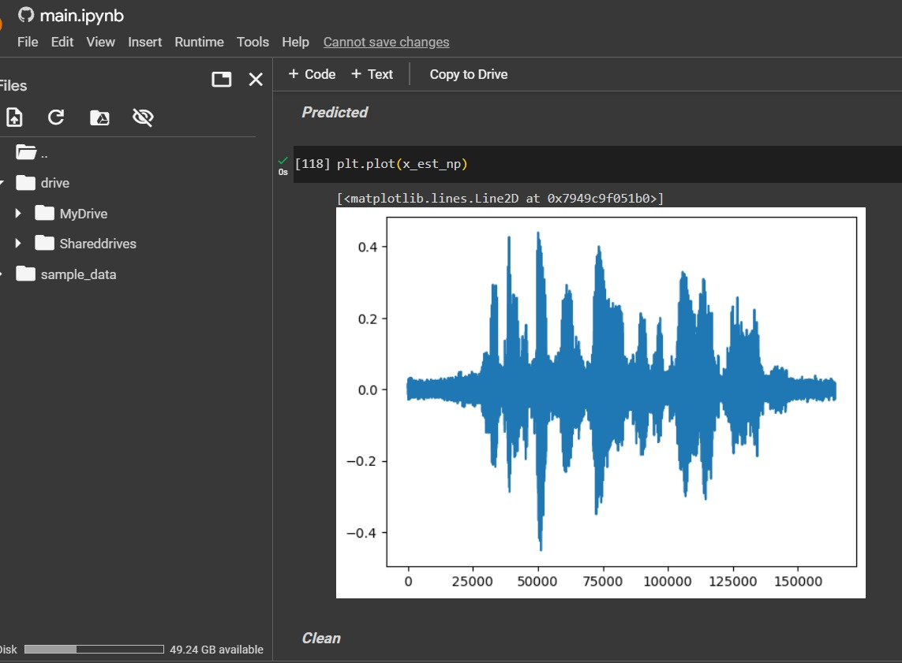
Predicted signal output
From the Model

Slide 17
Thank You!

